Slide 1
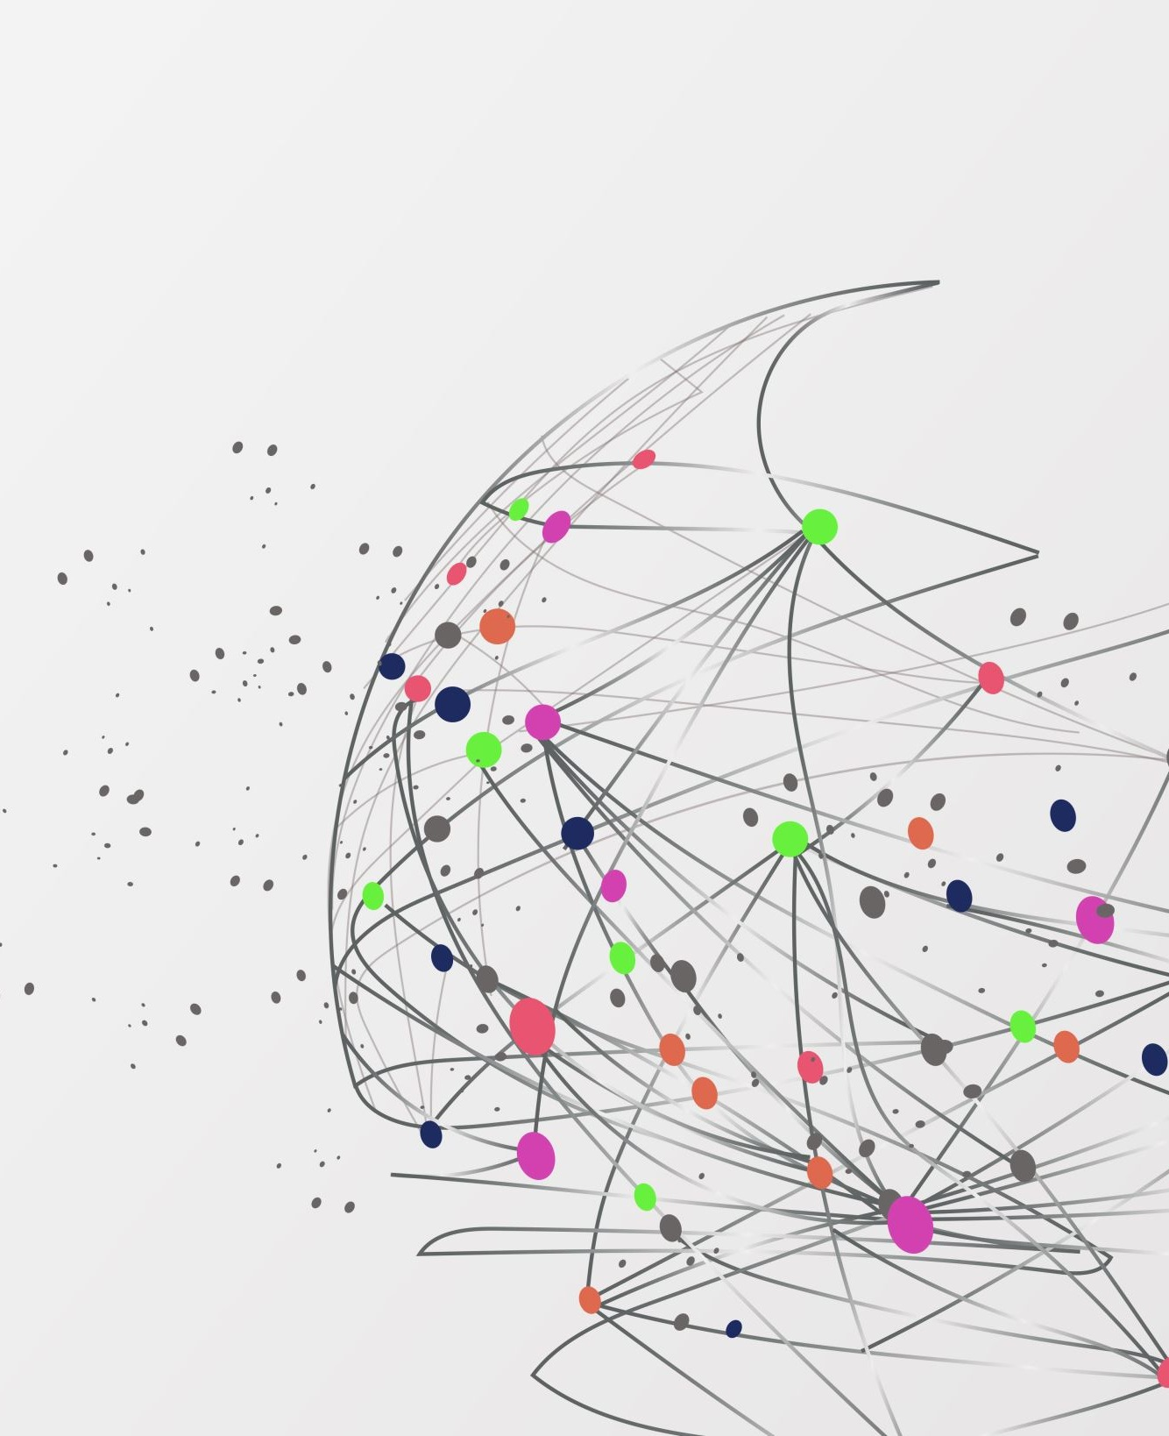
Describing Data and Spotting Outliers
Descriptive statistics, distributions and charts

Slide 2
What is descriptive data?
Descriptive
Summarizes what the data looks like now.
A few numbers or one picture for many rows.
Examples: average, range, a histogram.
Predictive (later)
Uses the data to guess something new.
Needs a clean, understood dataset first.
Weeks 7 and 9.

Slide 3
Why we need descriptive statistics
See the big picture
Thousands of rows become a few numbers.
Catch bad data
An impossible maximum shows a mistake.
Compare groups
Is this group higher than that group?
Choose next steps
The shape decides which method to use.

Slide 4
Min, max and range
Example: hours studied by 8 students
2
4
4
4
5
5
7
9
Statistic | Formula | Our data | Tells you
Min | Smallest value | 2 | Lowest end
Max | Largest value | 9 | Highest end
Range | Max − Min | 9 − 2 = 7 | How spread out. Check for impossible values.

Slide 5
Mean (the average)
mean = (x₁ + x₂ + … + xₙ) ÷ n
2
4
4
4
5
5
7
9
(2+4+4+4+5+5+7+9) ÷ 8 = 40 ÷ 8 = 5
Tells you
A typical value, the balance point.
Watch out
One extreme value pulls the mean.

Slide 6
Median and mode
median = the middle value
(sorted; even count: average the middle two)
mode = the most common value
(works for labels too)
2
4
4
4
5
5
7
9
Median = (4 + 5) ÷ 2 = 4.5
Tells you: the middle. Not moved by extremes.
Mode = 4 (appears 3 times)
Tells you: the most common answer.

Slide 7
Trimmed mean: ignore the extremes
3
4
5
6
6
7
7
8
9
25
Sorted values. Drop the lowest and the highest (10% from each end).
Statistic | How | Value
Mean | Add all 10, divide by 10 | 8.0
Median | Middle of the sorted values | 6.5
Trimmed mean | Drop 3 and 25, average the other 8 | 6.5
Notes:
A trimmed mean drops a fixed share of the lowest and highest values, then averages the rest. Here we drop the lowest 10 percent and the highest 10 percent, which is one value from each end of 10. The mean is 8.0, pulled up by 25. The trimmed mean is 6.5, close to the median 6.5. It sits between the mean and the median: it uses most of the data, but one extreme value cannot drag it. Orange does not report it directly, so compute it by hand once to see the idea.

Slide 8
Std (standard deviation)
std = √[ Σ(x − mean)² ÷ (n − 1) ]
x | x − mean | (x − mean)²
2 | −3 | 9
4 | −1 | 1
4 | −1 | 1
4 | −1 | 1
5 | 0 | 0
5 | 0 | 0
7 | 2 | 4
9 | 4 | 16
Sum of squares = 32
Variance = 32 ÷ 7 = 4.57
std = √4.57 = 2.14
Small std: values close to the mean. Large std: spread out.

Slide 9
What each statistic tells you
Statistic | Gives insight into | Watch out
Min, max | Lowest and highest, impossible values | Sensitive to outliers
Range | Total spread | Uses only two values
Mean | Typical value, balance point | Pulled by extremes
Median | Middle value | Ignores the size of extremes
Mode | Most common value, also for labels | May not exist or be repeated
Std | How spread out around the mean | Also pulled by extremes

Slide 10
Box plot: see the outlier
Weekly study hours of 15 students
0
5
10
15
20
25
Min | Q1 | Median | Q3 | Max (no outlier) | Outlier
3 | 5 | 6 | 8 | 9 | 25
The orange dot sits far from the box: a visual outlier.

Slide 11
Scatter plot: see the outlier
How to read it
Most points form a cloud that rises.
The orange point is far from the cloud.
Ask: is it a real case or a mistake?

Slide 12
How to calculate Q1 and Q3
3
4
4
5
5
5
6
6
6
7
7
8
8
9
25
Lower half (7 values)
Median 6
Upper half (7 values)
Q1 = 5
Q3 = 8
1 Sort
Put the values in order (already sorted here).
2 Split
Find the median. Split into two halves. Leave the median out.
3 Q1 and Q3
Q1 = median of the lower half. Q3 = median of the upper half.
IQR = Q3 − Q1 = 8 − 5 = 3

Slide 13
IQR method
IQR = Q3 − Q1
Outlier if below Q1 − 1.5 × IQR or above Q3 + 1.5 × IQR
Step | Our data
Q1 and Q3 | 5 and 8
IQR | 8 − 5 = 3
Lower fence | 5 − 1.5 × 3 = 0.5
Upper fence | 8 + 1.5 × 3 = 12.5
Check 25 | 25 > 12.5: outlier
Not pulled by the outlier itself. Works for skewed data.

Slide 14
Z-score method
z = (x − mean) ÷ std
Outlier if z > 3 or z < −3 (some use 2.5)
Step | Our data
Mean and std | 7.2 and 5.20
z for 25 | (25 − 7.2) ÷ 5.20 = 3.42
z for 9 | (9 − 7.2) ÷ 5.20 = 0.35
Check | 3.42 > 3: outlier
The outlier raises the mean and std, so it can hide itself.

Slide 15
IQR or Z-score?
 | IQR method | Z-score method
Built from | Quartiles (medians) | Mean and std
Best for | Any shape, skewed data | Bell-shaped data
Weakness | Rule of 1.5 is a convention | Outlier distorts mean and std
Companion picture | Box plot | Histogram or scatter plot
A flagged value is a question, not an answer.

Slide 16
What to do with an outlier
Remove
Data entry errors and glitches.
Example
25 hours typed instead of 2.5
Keep
Genuine extreme events.
Example
A real record sale or flood
Alternatives
Cap it, or transform it.
Example
Cap at the fence, or take the log
Decide by asking: could this be real? Then write it in your cleaning log.

Slide 17
What the outlier does to the numbers
Statistic | With the 25 | Without the 25
Mean | 7.2 | 5.9
Median | 6 | 6
Std | 5.20 | 1.73
Range | 22 | 6
The median barely moves. The mean and std do.

Slide 18
What is a histogram?
How to read it
Each bar is a bin, like 65 to 70.
Height = how many values fall in it.
The overall outline is the distribution.

Slide 19
Types of distributions
Shape | Definition | Example
Normal (bell) | Symmetric, most values near the middle | Heights, exam scores
Uniform | All values about equally likely | Rolling a die
Right-skewed | Long tail to the high side | Income, commute time
Left-skewed | Long tail to the low side | Scores on an easy exam
Bimodal | Two peaks (two groups mixed) | Heights of a mixed group
Extreme value (Gumbel) | Skewed right, models the yearly maximum | Highest flood each year

Slide 20
Normal and uniform distributions
Normal: most near the middle. Uniform: all equally likely.

Slide 21
Skewed distributions
The tail points to the skew. Mean is pulled toward the tail.

Slide 22
Bimodal and extreme value distributions
Bimodal: look for two groups. Gumbel: long right tail.

Slide 23
Bernoulli and binomial shapes
Bernoulli: one yes/no try. Binomial: how many yeses in n tries.
Notes:
Bernoulli is one try with two outcomes: a player churns (1) or does not (0), with probability p. The chart shows p = 0.3. Binomial counts how many successes you get in n tries. With 10 players who each churn with probability 0.3, the number who churn is most often 3, and the shape is a hill that leans right. Use these for yes/no columns and for counting yes answers. Made-up p.

Slide 24
Poisson and exponential shapes
Poisson counts events in a window. Exponential measures the wait between them.
Notes:
Poisson counts events in a fixed window when events happen at a steady average rate: logins per day, bug reports per week. The chart uses an average of 3 per day. Exponential is the other side of the same process: the waiting time between events. Short waits are most common and long waits are rare, so it is a right-skewed curve that starts high and falls. The chart uses an average wait of 2 days. Poisson counts, exponential waits. Made-up rates.

Slide 25
Right-skewed vs Gumbel
 | Right-skewed | Gumbel (extreme value)
What it is | A description of a shape | A specific named distribution
Where it comes from | Many causes: income, waiting times | The largest value in each group
Example | Commute minutes | Highest river level each year
Peak | Often near the low end | Peak away from zero, then a tail
Melt Pool data | Melt pool intensity | Cooling rate
Every Gumbel is right-skewed. Not every right-skewed dataset is Gumbel.

Slide 26
The shape tells you which statistic to use
Shape | Mean vs median | Report
Symmetric (normal) | About equal | Mean or median
Right-skewed | Mean > median | Median
Left-skewed | Mean < median | Median
Bimodal | Middle falls between the peaks | Describe each group separately

Slide 27
Log transform: squash a long tail
Use on positive, right-skewed columns. Keep the original.
Notes:
A log transform replaces each value with its logarithm. Large values shrink a lot and small values shrink a little, so a long right tail becomes closer to a normal hill. Use it for right-skewed positive columns like spend or hours played. It cannot be applied to zero or negative values, so add a small constant or leave those rows out. In Orange use the Formula widget, for example log10(spend). Keep the original column. Made-up data.

Slide 28
Scatter plot and correlation
r = 0.87
Direction: positive.
Strength: strong.
−1 to +1. Near 0 means no straight-line pattern.

Slide 29
Explanatory vs response variable
Explanatory
Does the explaining. Goes on the x axis.
Response
Is being explained. Goes on the y axis.
The question decides which is which.
Notes:
Every scatter plot needs a decision about which column goes on which axis. The explanatory variable is the one we think does the explaining: it goes on the x axis. The response variable is the one we are trying to explain: it goes on the y axis. The choice comes from the question, not from the data. Asking whether more play time means more spend makes hours the explanatory variable and spend the response. Asking the other way round swaps them. Correlation itself does not care, but the trendline and the story do.

Slide 30
Reading the correlation number
Near +1: rise together. Near 0: no line. Near −1: one rises, the other falls.

Slide 31
A trendline can chase an outlier
Slope with the outlier: 1.1. Without it: 2.0. Draw it both ways.
Notes:
A trendline is the straight line that best fits the points. One outlier can tilt it. Left: with the outlier, the slope is about 1.1. Right: without it, the slope is about 2.0. Always draw it both ways. If the story changes a lot, say so in the report. If the outlier is a real error, remove it and say why; if it is real, keep it and explain. In Orange, the Scatter Plot widget has Show regression line, and you can use Select Rows to remove the outlier and compare. Made-up data.

Slide 32
Correlation does not equal causation
r = 0.98: they rise together
Exam weeks
More coffee sold
More library visits
Coffee does not cause library visits. Exam weeks drive both.

Slide 33
Ask first: what is this chart for?
Compare groups
Which platform spends most?
See a shape
Is spend skewed? Any two humps?
See a relationship
Does more play mean more spend?
See change
Is churn going up over months?
Finish the sentence: "I want the reader to see ___."
Notes:
Before making any chart, finish the sentence: I want the reader to see ___. Four common purposes: compare groups, see a shape, see a relationship, see change over time. The purpose picks the chart on the next slide. If you cannot finish the sentence, you are not ready to make the chart, you are still exploring. That is fine in Orange, but do not paste that chart into a report.

Slide 34
Choosing the right chart
Question | Chart | Example
Compare categories | Bar chart | Sales by item
Change over time | Line chart | Temperature each day
Relationship of two numbers | Scatter plot | Hours vs score
Shape of one number | Histogram or box plot | Exam scores
Parts of a whole (few parts) | Pie or stacked bar | Share of majors

Slide 35
Pick the chart for the question
Question | Chart | Orange widget
What shape is one number? | Histogram | Distributions
Compare a number across groups | Box plot or violin plot | Box Plot, Violin Plot
Two numbers: related? | Scatter plot | Scatter Plot
A number over time | Line chart | Line Plot
Counts or averages by label | Bar chart | Bar Plot
Two labels together | Stacked bar or mosaic | Mosaic Display
Many numbers at once | Heat map | Heat Map
Notes:
This replaces guessing. Left column is the question, middle is the chart, right is the Orange widget. Box Plot and Scatter Plot we have used already. New: Violin Plot, Line Plot, Bar Plot, Heat Map and Mosaic Display. Widget names may differ slightly by Orange version, so check the Visualize menu. Pie charts are not on the list on purpose: people read angles badly, bars are clearer.

Slide 36
Bar chart or line chart?
Bars for separate labels. Lines for an ordered axis such as time.
Notes:
Bars compare separate categories. Lines show change across an ordered axis, usually time. Never connect points with a line when the x axis is just labels like PC, Console and Mobile, because the line suggests something in between that does not exist. Use a line when the x axis is months, days or any order where in-between makes sense. Made-up numbers.

Slide 37
Box plot vs violin plot
Box plot
0
20
40
60
80
Violin plot
Same data. The violin shows the two humps. The box hides them.
Notes:
A box plot shows five numbers: lowest, Q1, median, Q3, highest. It hides the shape. A violin plot shows the whole shape of the data, so two humps (bimodal) are visible. Here both plots are drawn for the same made-up data with two groups of players, one around 20 hours and one around 60. The box plot puts the median in the empty valley between them and looks like one group. Orange has both: Box Plot and Violin Plot.

Slide 38
Heat map: a table with colors
 | Hours | Spend | Satisfaction | Days idle
Hours | 1.00 | 0.62 | 0.35 | -0.48
Spend | 0.62 | 1.00 | 0.28 | -0.30
Satisfaction | 0.35 | 0.28 | 1.00 | -0.52
Days idle | -0.48 | -0.30 | -0.52 | 1.00
How to read it
Dark green: move together.
Dark amber: move opposite.
Pale: little relationship.
Notes:
A heat map colors each cell of a table by its value, so patterns jump out. The usual use is a correlation table: every column against every other. Dark green is a strong positive relationship, dark amber is a strong negative one, and pale is near zero. Read the numbers too, not only the colors. The diagonal is always 1 because a column matches itself. These numbers are made up. In Orange, the Correlations widget gives the numbers and the Heat Map widget colors a data table.

Slide 39
Two labels: stacked bars
Use it when
Both columns are labels.
You ask: does one label depend on the other?
Here: churn is higher on Mobile.
Notes:
When both columns are labels, there is nothing to average, so count. A 100 percent stacked bar shows, inside each platform, what share churned. This is the chart for the question: does churn depend on platform? Equal-height bars make the shares easy to compare. The made-up numbers show churn higher on Mobile. Orange's Mosaic Display widget does the same with area, and it can use more than two labels.

Slide 40
Traditional vs dynamic graphs
Compare | Traditional (static) | Dynamic (interactive)
What it is | A fixed picture | A graph you can act on
Viewer can | Look | Hover, zoom, filter, select
Best for | Reports, print, one message | Exploring, checking, asking new questions
In Orange | Save the plot as an image | Select points in Scatter Plot and see them in a Data Table
Same data. The difference is what the viewer can do.
Notes:
A traditional (static) graph is a fixed picture: it looks the same for everyone and is made to be printed or pasted into a report. A dynamic (interactive) graph responds to the viewer: hover to read values, zoom, filter, or select points and see which rows they are. Neither is better by itself. The choice depends on the job, which the next slide covers. This addresses essential outcome 2.3. Students already used dynamic graphs without the name: hovering over a Box Plot in Orange to read Q1, median and Q3.

Slide 41
When a dynamic plot is better
Situation | Better choice | Why
Hundreds of points, outliers to identify | Dynamic | Hover or select shows which rows they are
Comparing many groups | Dynamic | Filter one group at a time
Exploring data you do not know yet | Dynamic | New questions need new views
One clear message in a report | Static | The reader should not have to work
Printed page or slide | Static | Nothing to click
Explore dynamically. Publish one static chart.
Notes:
Justification rules students can use. Choose dynamic when the viewer needs to find or check something in the data: too many points to label, outlier rows to identify, groups to compare by filtering, or a question you did not know in advance. Choose static when there is one clear message and the reader should not have to work: a report figure, a printed page, a slide. Many projects use both: explore dynamically, then publish one static chart. Assignment 1 asks students to justify one choice in a sentence.

Slide 42
Interactive widgets in Orange
Widget | What you can do
Scatter Plot | Hover for a row, zoom, select points and send them on
Box Plot | Hover to read Q1, median and Q3; split by a label
Violin Plot | Hover over the shape; split by a label
Heat Map | Select a block of rows or columns and send it on
Data Table | Shows the rows you selected in another plot
Select in a plot. See the rows in a Data Table.
Notes:
Where dynamic graphs are taught: Orange widgets are interactive by default, and widgets connected by lines are linked, so a selection in one passes the selected rows to the next. Walk through the exercise: connect File to Scatter Plot, select a cluster of points, connect Scatter Plot to Data Table, and read the selected rows. Then connect the selection to Box Plot to compare it with everyone else. Widget names may vary slightly by version.

Slide 43
Bad graph 1: the truncated axis
Same data. Right looks like a big gap: B is more than double A.

Slide 44
Bad graph 2: other tricks
3D tricks
Perspective makes front items look bigger.
Example: in a 3D pie, a 25% slice in front looks bigger than a 30% slice at the back.
Misleading scales
Different or uneven axes for the same data.
Example: sales of 900 to 1,000 look like a jump on one axis and flat on another.
Cherry-picked range
Show only the part that fits the story.
Example: show the best 4 months and hide 8 months of decline (next slide).
Clutter
Too much on one chart.
Example: 10 colors, no title, no units. Nobody knows where to look.

Slide 45
Bad graph 3: cherry-picked range
Both charts use true numbers. Ask: what period is shown, and why?

Slide 46
Before you share a chart
Right chart?
Does the chart type match the question?
Honest axis?
Do bars start at zero? Are ticks even?
Labeled?
Title, axis names and units.
Simple?
Few colors, no 3D, no clutter.
Sourced?
Say where the data came from.

